Slide 1
“THE MILLENNIALS”
Guide:
Assistant Prof. Dhaval Bhoi
Prepared by:
Prachi Desai (22CE025)
Smit Gandhi (22CE031)
Dhruvil Joshi (22CE044)

Slide 2
TABLE OF CONTENTS
About the project……………………………………………………………………………………3
Description of our project
Technologies………………………………………………………………………………………...4
Technologies used
Why The Millennials?………………………………………………………………………………5
Logo of the website
Features of website
Screenshots……………………………………………………………………………………...….7
Screenshots of Website
Updates in the website………………………………………………………………………...….17
Updates added in the website
Upcoming updates

Slide 3
ABOUT THE PROJECT
This is a web development project of a Gaming website(online free games simulator)
“The Millennials” aims to display childhood on digital platform
This website allow users to experience their childhood games with a pinch of tech which gives them feeling of nostalgia and despite being any age they can recall their good old days.
It contains various games having their own extra elements as well as maintains it’s own ethinicity.

Slide 4
TECHNOLOGIES
The languages used in creating, designing and making our website user-interactive are:
HTML (HyperText Markup Language) : To create skeleton of website
CSS (Cascading Style Sheets) : To design and animate webpage
JavaScript : To make the website user-friendly and add various functions to it

Slide 5


Why The Millennials?

Slide 6
FEATURES
Nostalgic
Mind-Refreshing
Responsive Design
User Registration and Login
Easy Navigation
Appealing UI and UX
Updates with regular interval

Slide 7
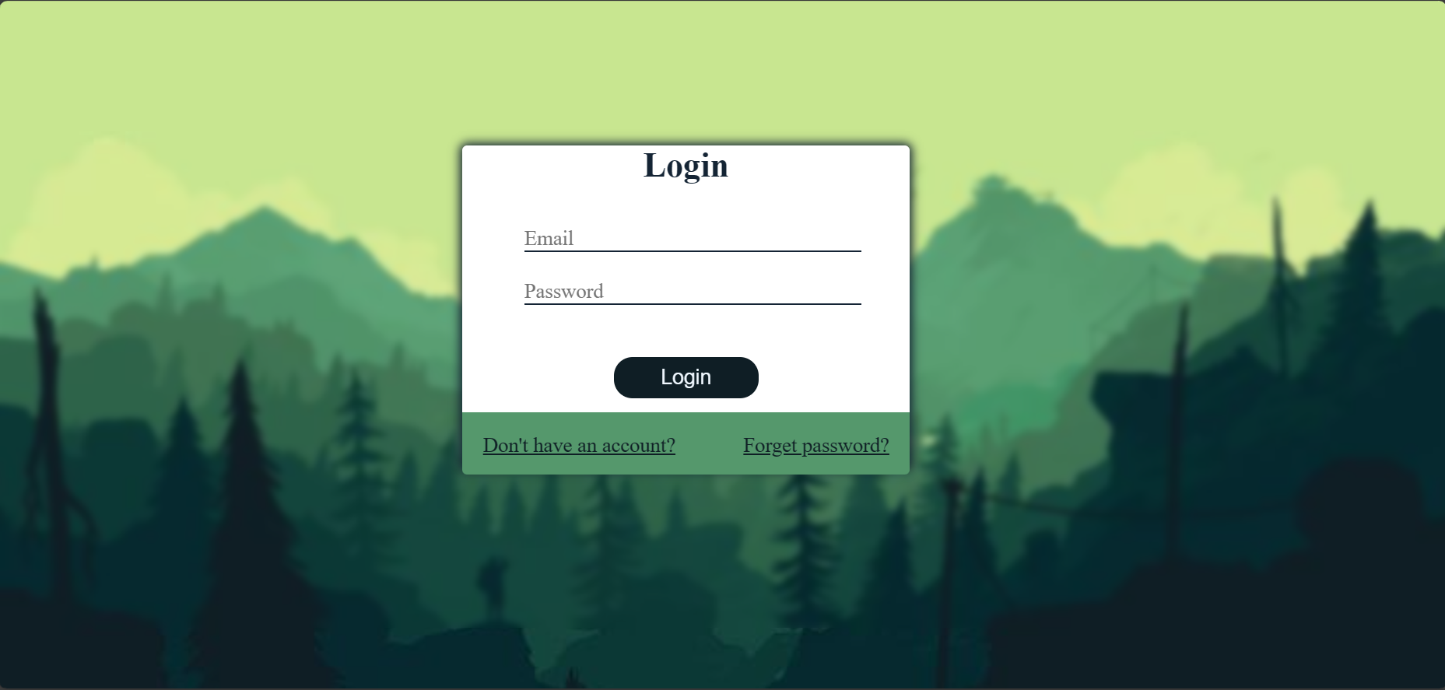
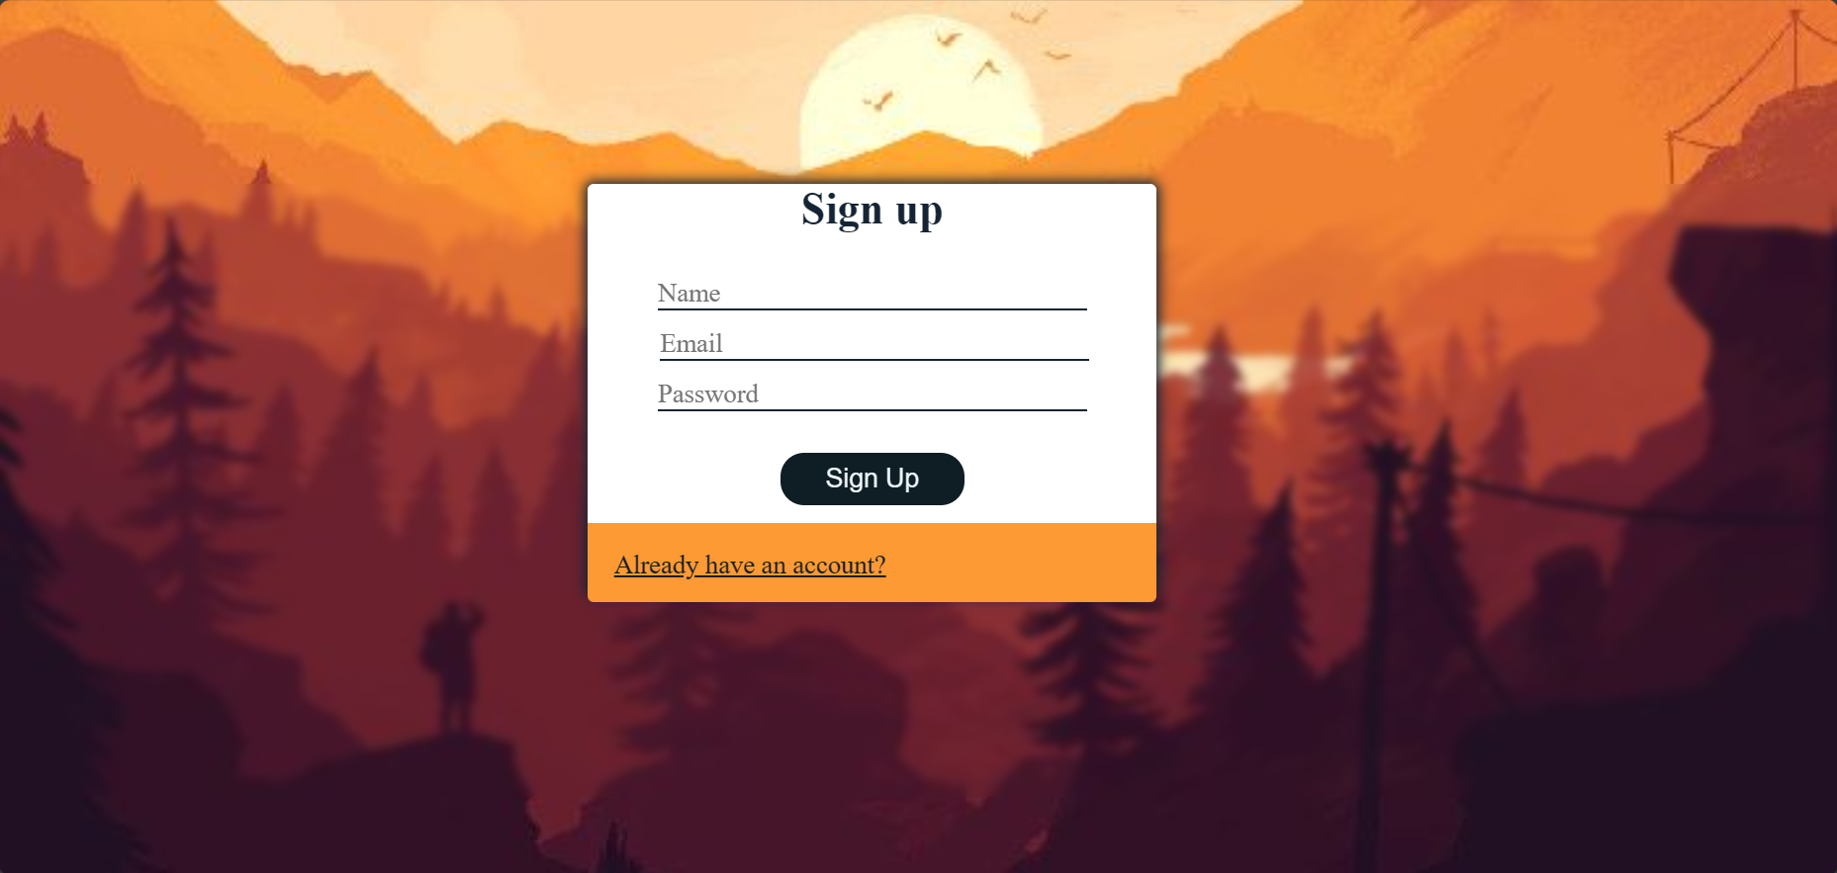
Screenshots
Login Page
Sign up Page

Slide 8

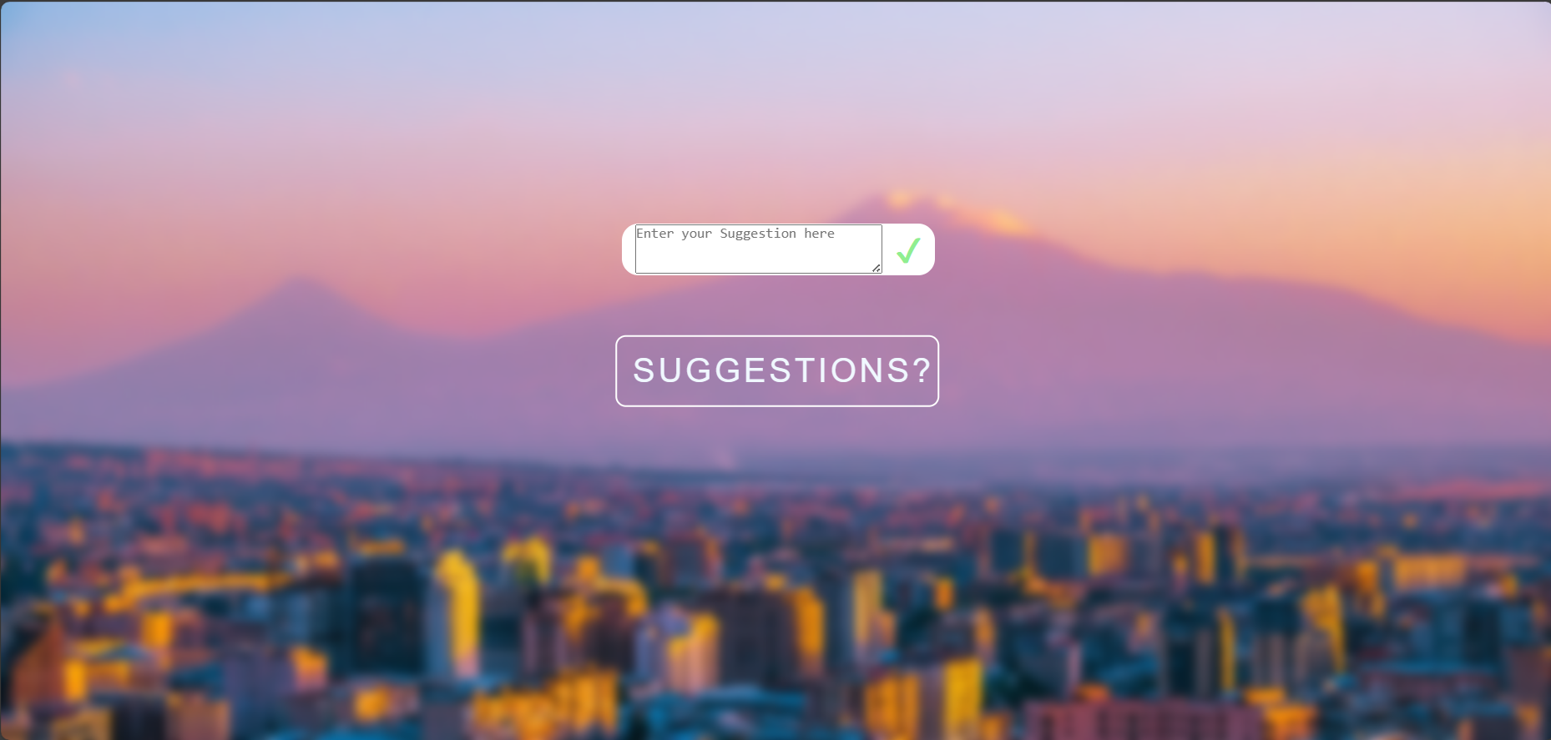
Screenshots
Suggestion Box

Slide 9
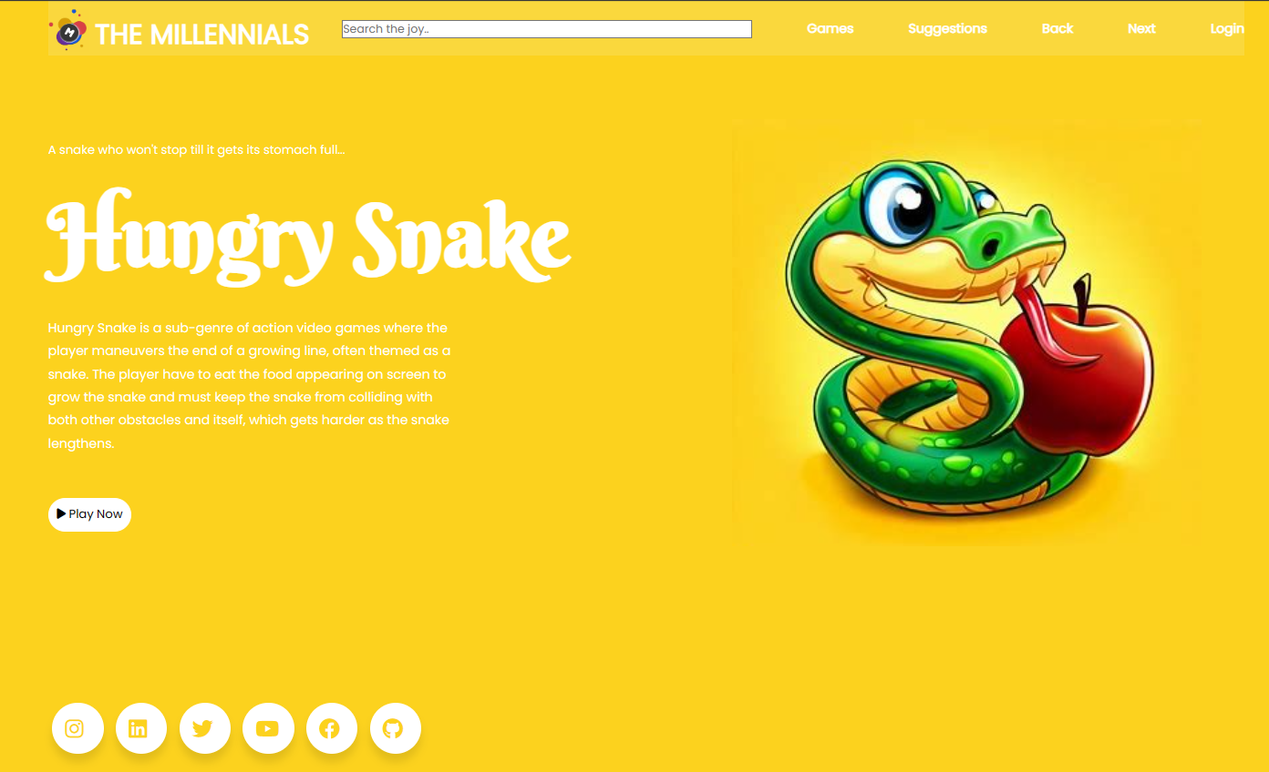
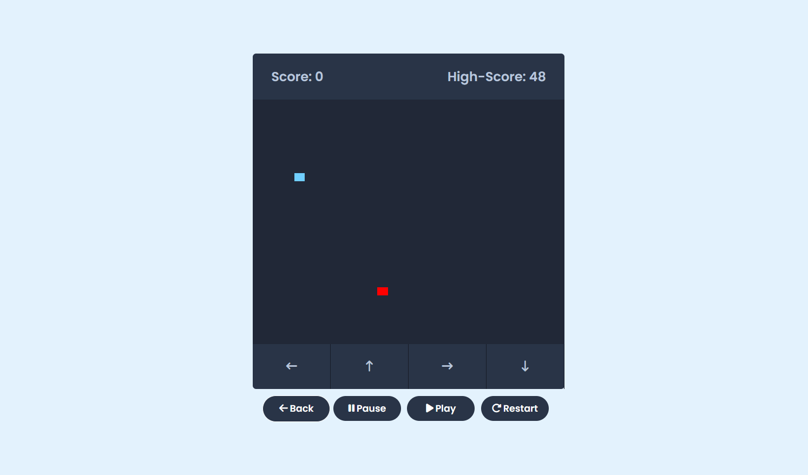
Screenshots
Hungry Snake

Slide 10
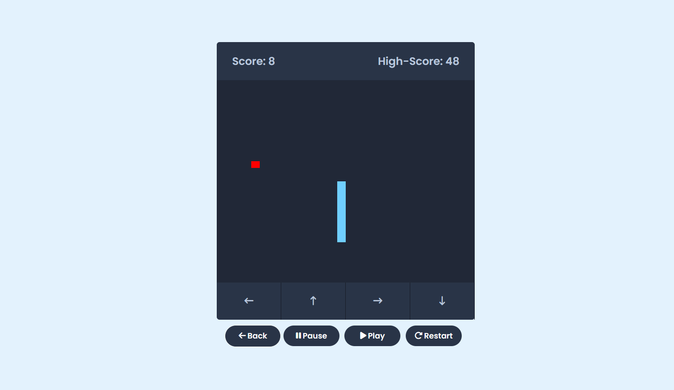
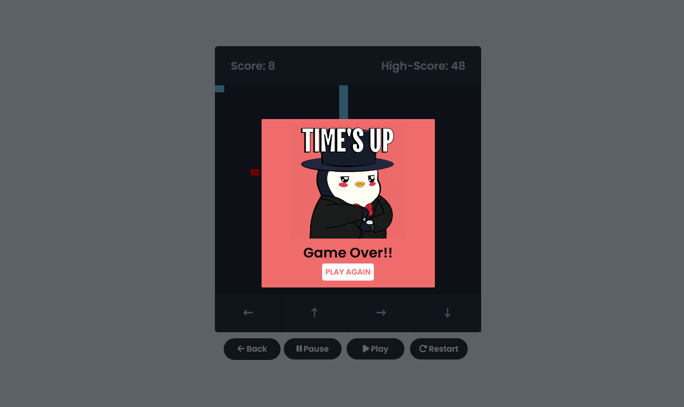
Screenshots
Hungry Snake

Slide 11
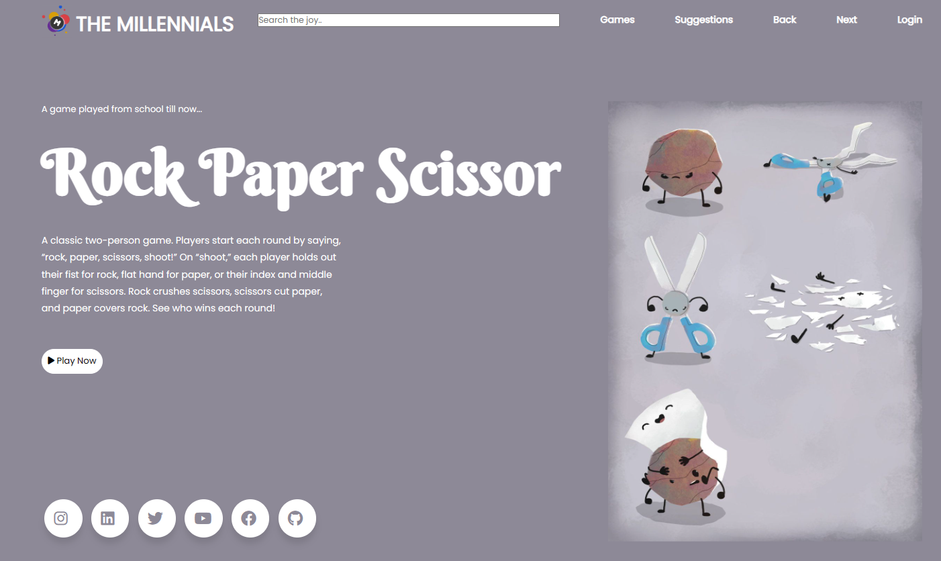
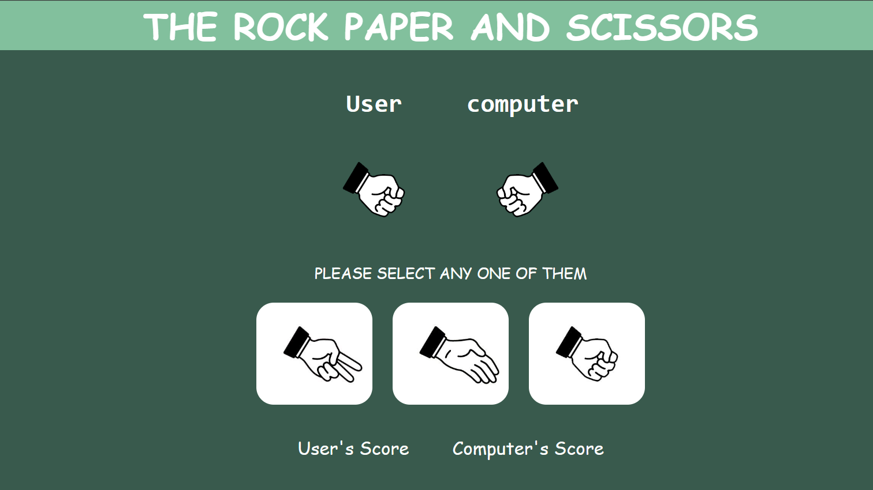
Screenshots
Rock Paper Scissors

Slide 12
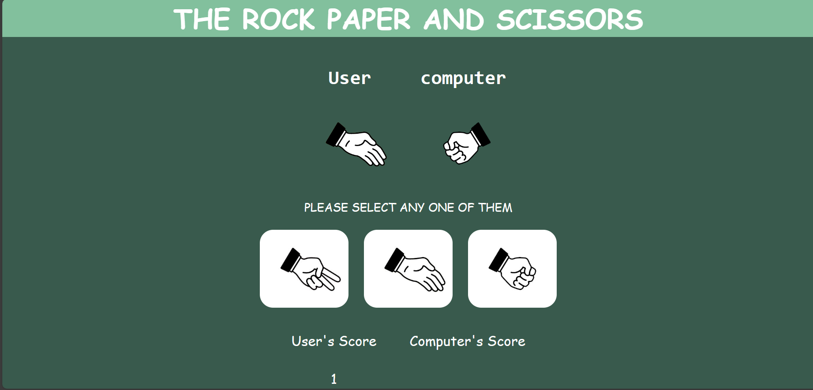
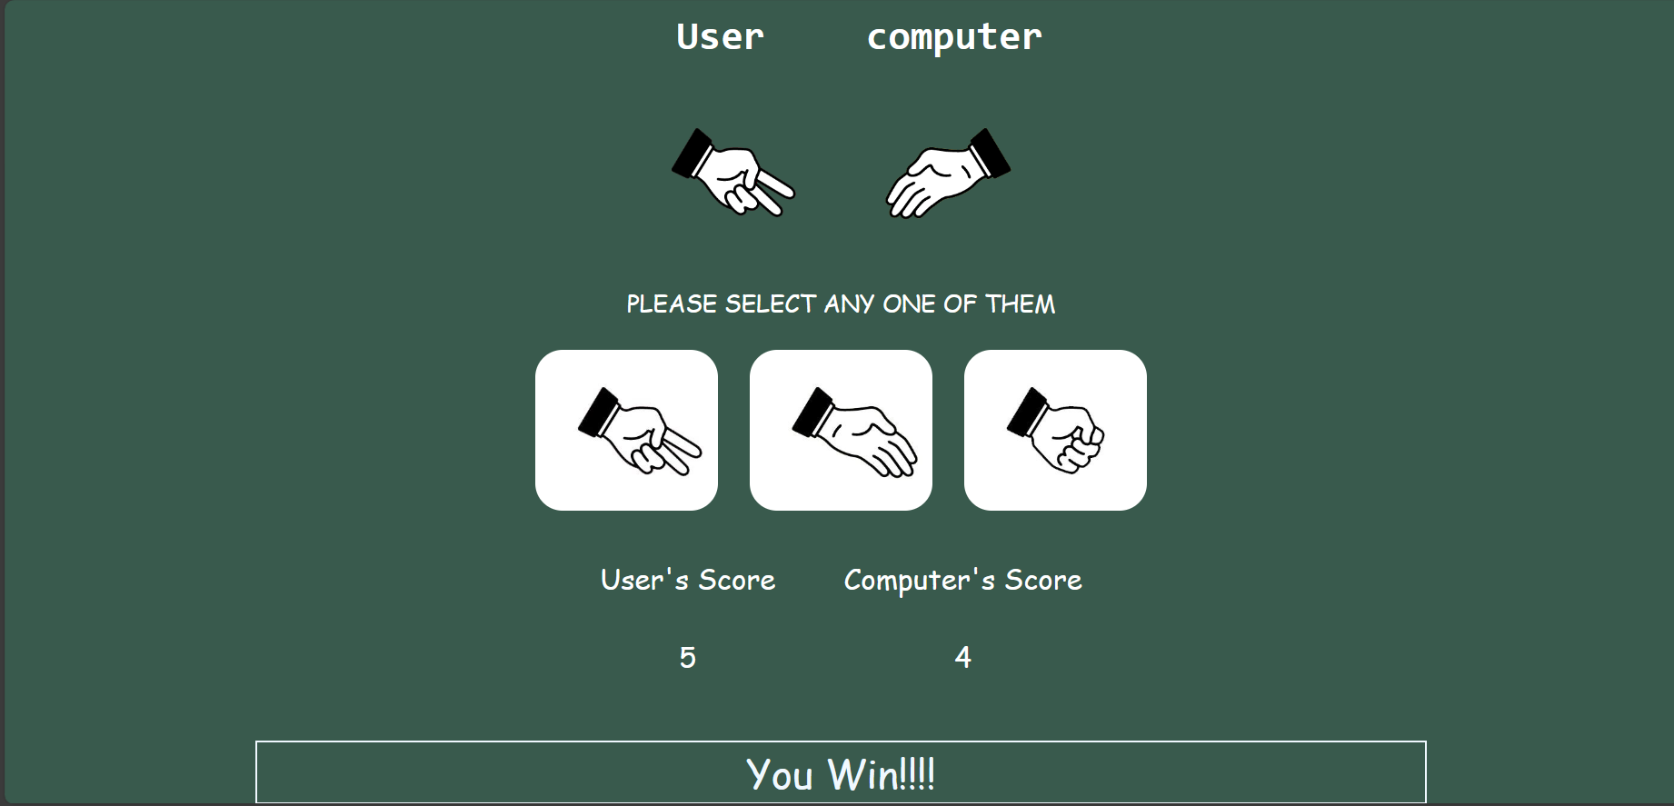
Screenshots
Rock Paper Scissors

Slide 13
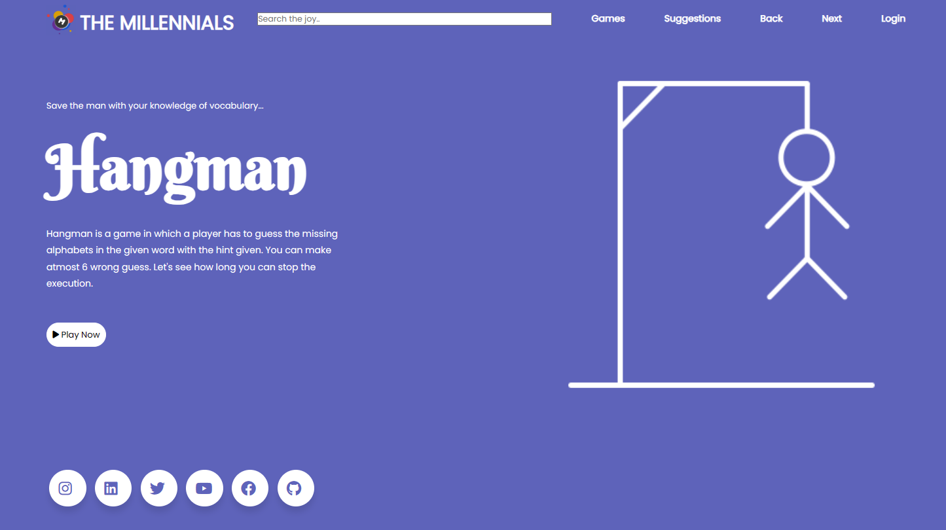
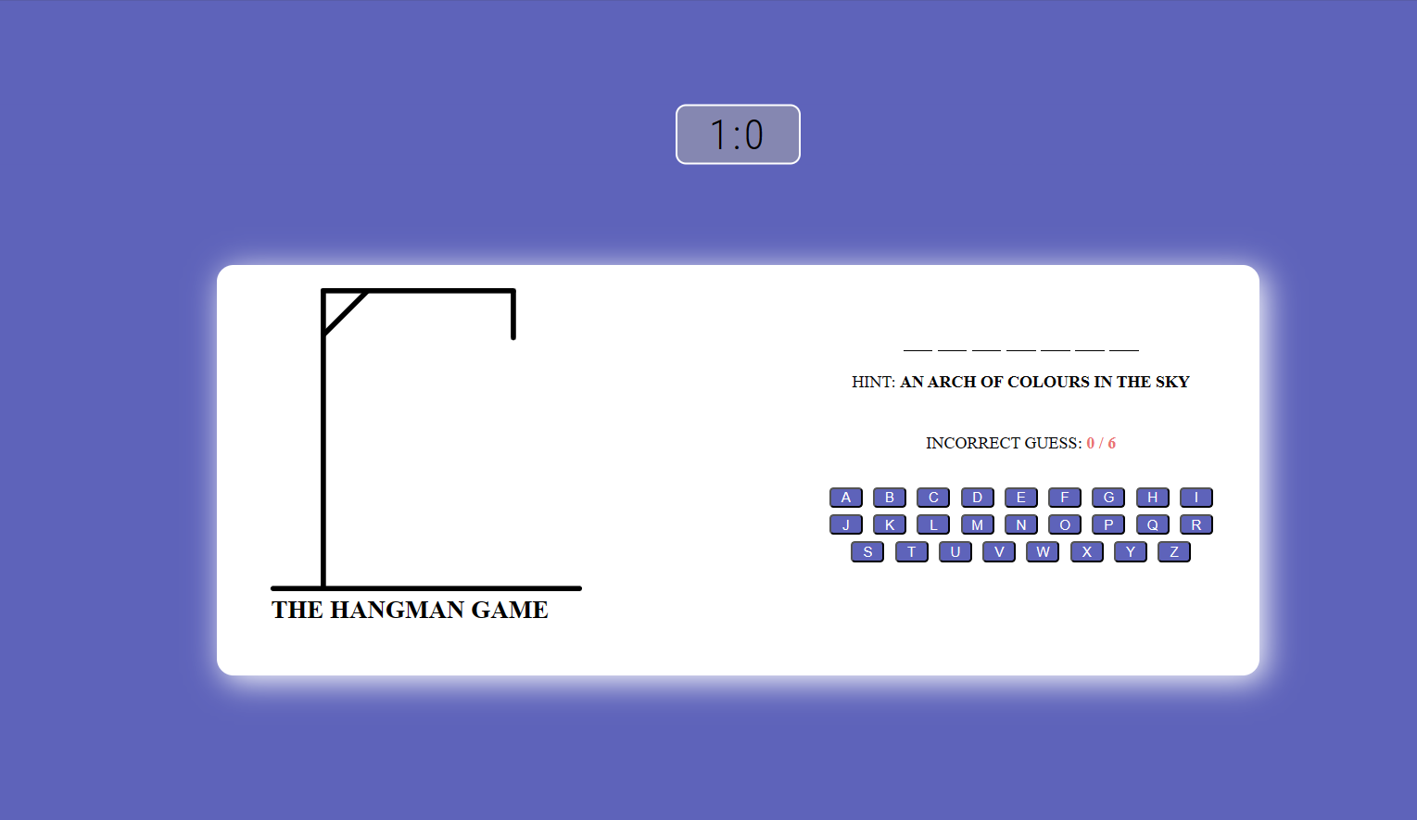
Screenshots
Hangman

Slide 14
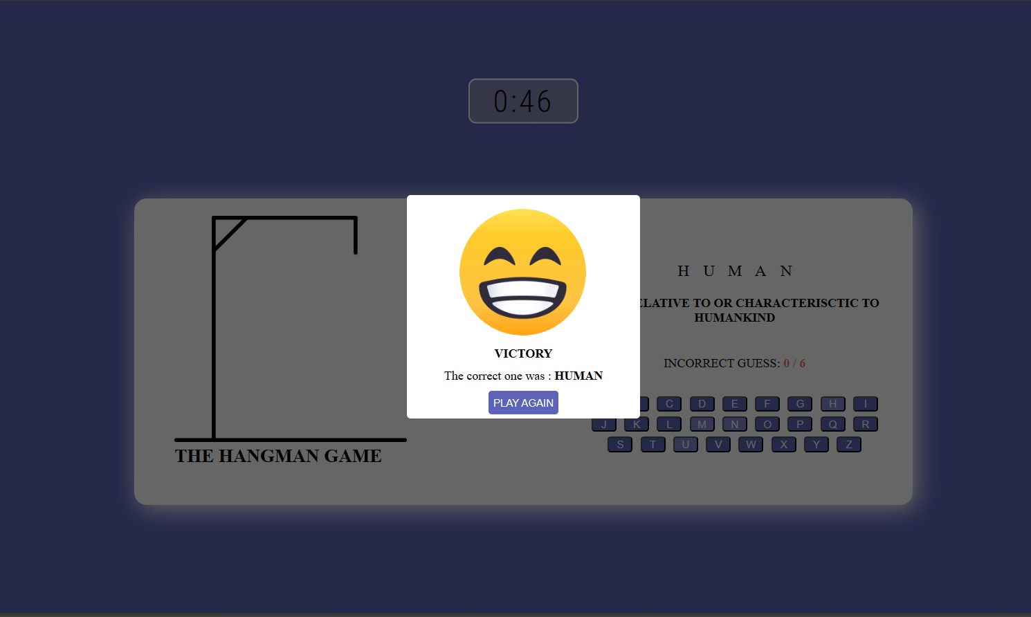
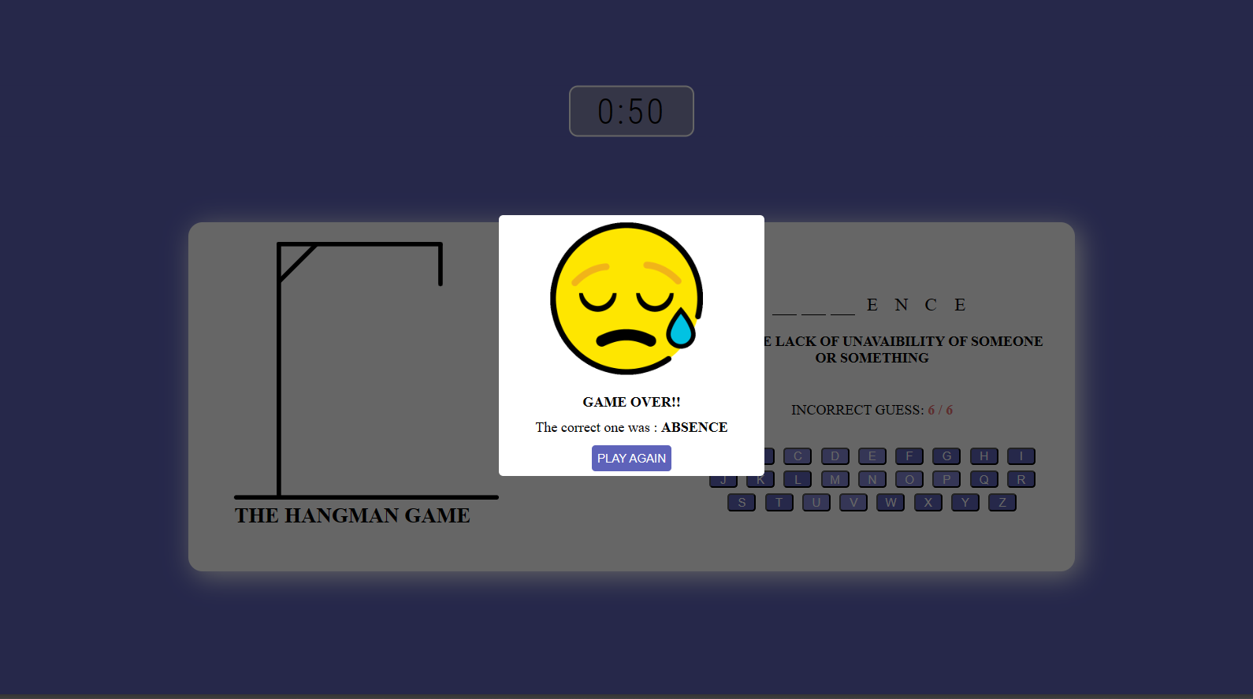
Screenshots
Hangman

Slide 15
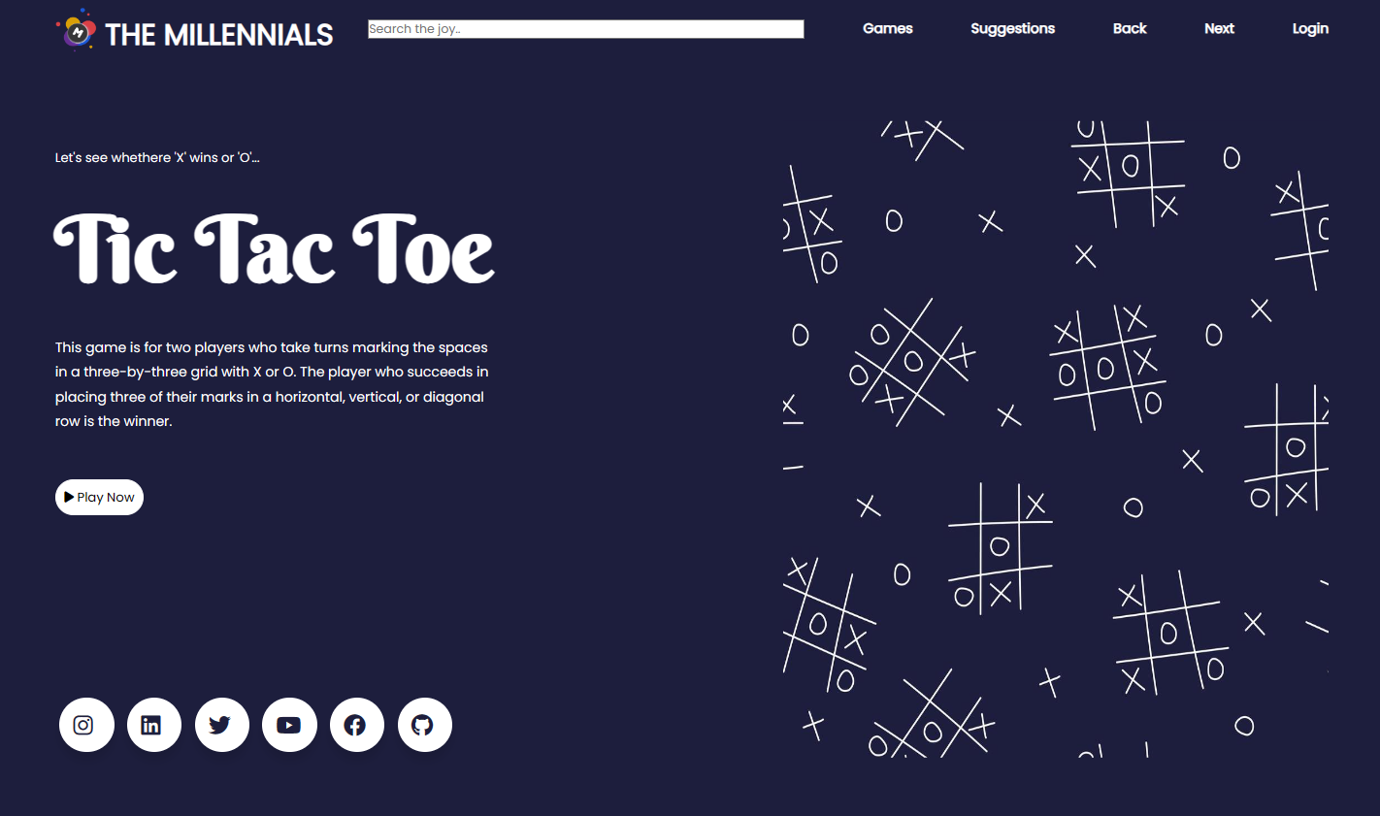
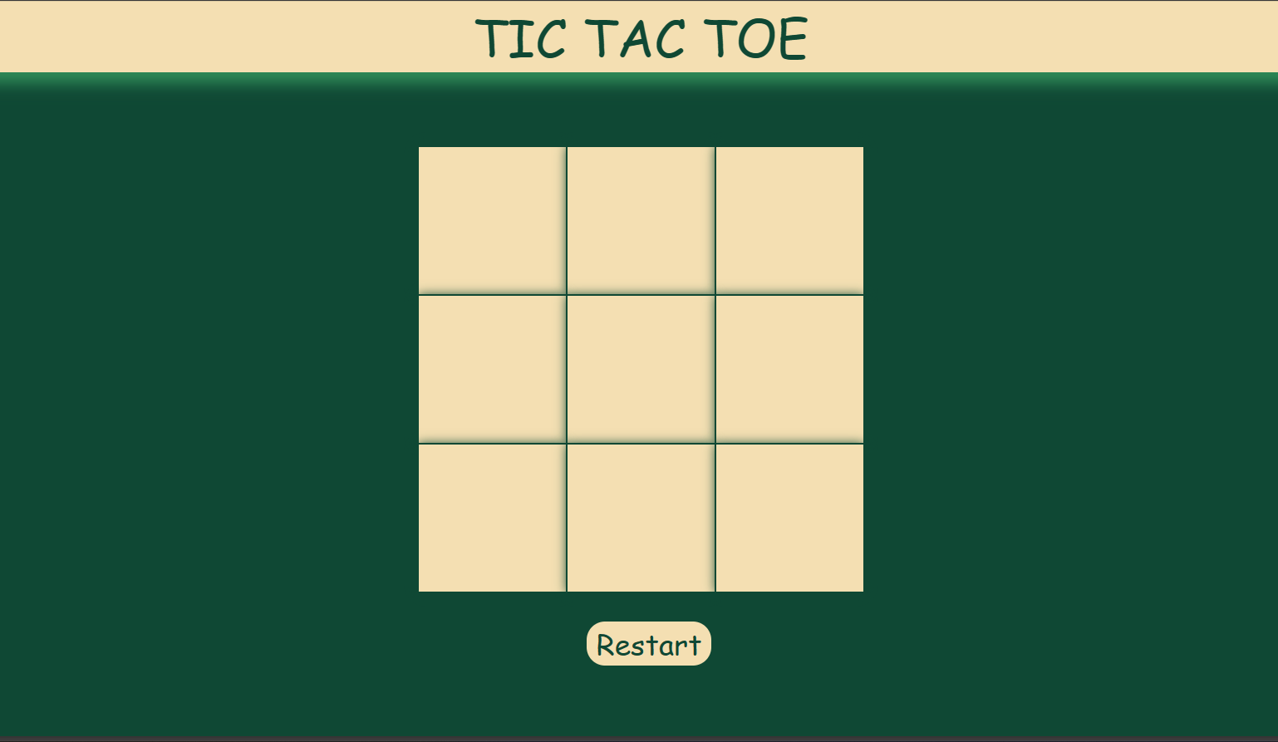
Screenshots
TIC TAC TOE

Slide 16
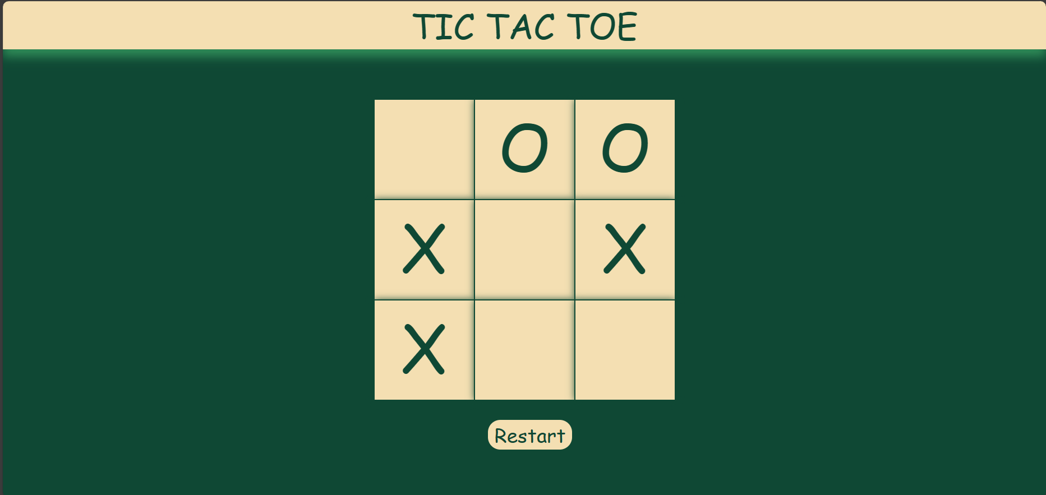
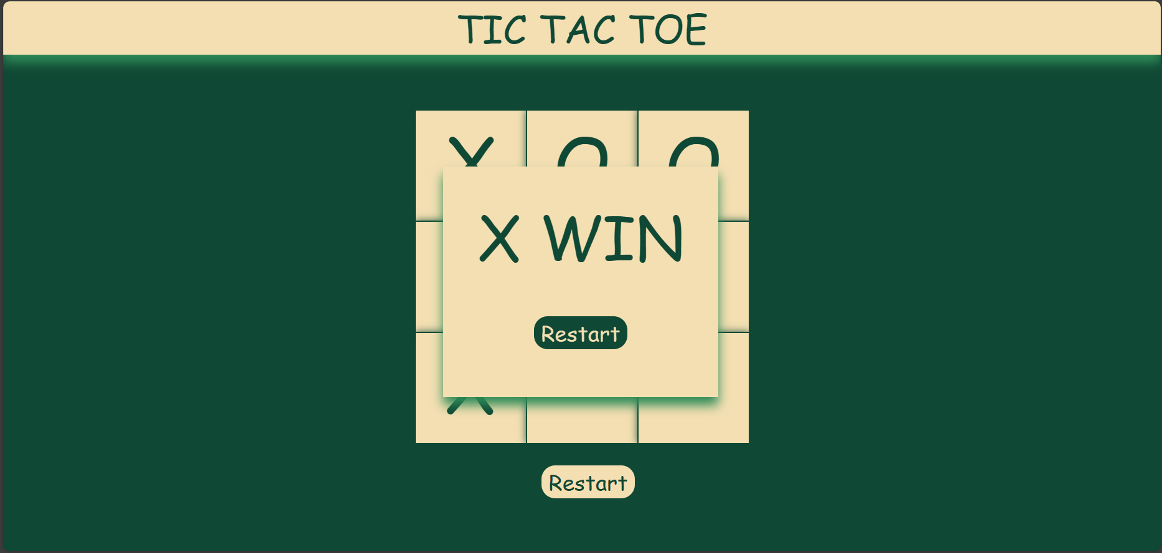
Screenshots
TIC TAC TOE

Slide 17
Updates added in the website
Sign up Page
Login of user by their credentials
Suggestion box

Slide 18
Upcoming updates
Login by Google Account using Google Oauth
Maintaining user information in database format
Tic Tac Toe with a puzzle version
And many more...

Slide 19
THANK YOU

